Slide 1
Designing conversing robots
Guest Lecture Social Robotics
Florian Kunneman
November 23rd 2021

Slide 2
Outline
Overview conversational agents
Designing and implementing your own conversational agent

Slide 3
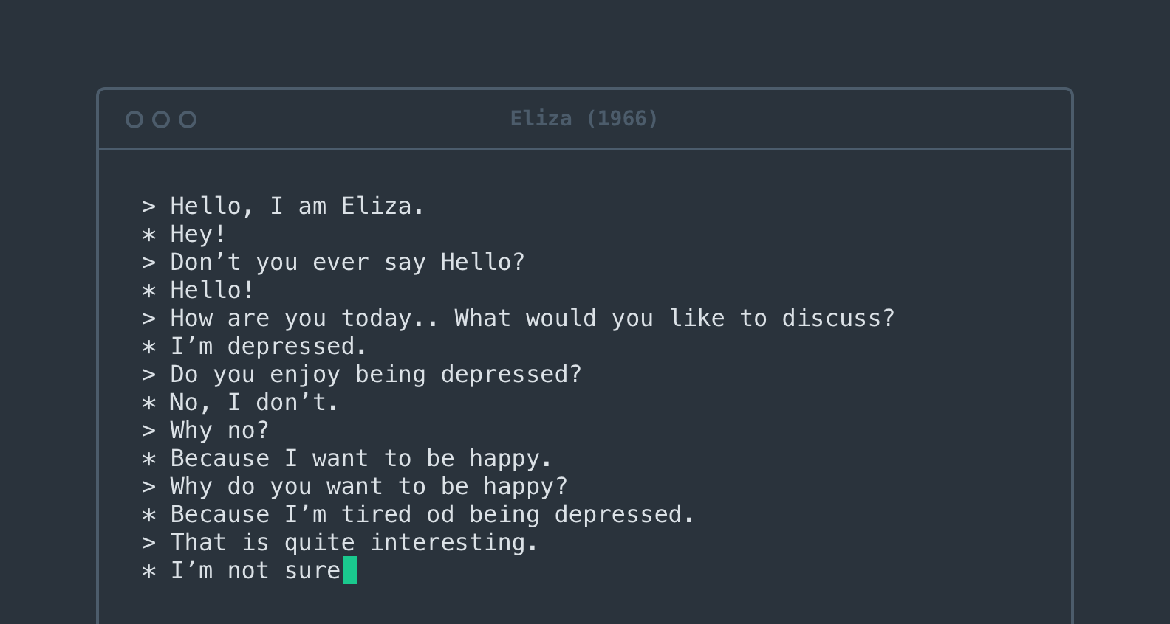
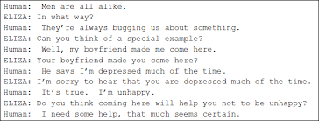
Joe Weizenbaum’s ELIZA (1965)

Slide 4
Mark Humphrys’ Mgonz (1989)
“cut this cryptic shit speak in full sentences.”
“ok thats it im not talking to you any more”
“ah type something interesting or shut up”

Slide 5
Early conversational agents
Little computational resources
No storage of earlier conversations
Nor a means to make use of such a storage
→ encourage / provoke the interlocutor to do the talking

Slide 6
Rollo Carpenter’s Cleverbot (2005)

Slide 7
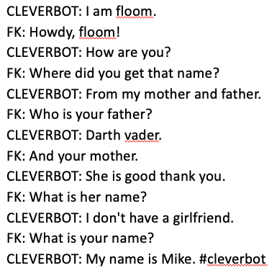
USER: Scaramouche, Scaramouche.
CLEVERBOT: Will you do the fandango?
USER: Thunderbolt and lightning.
CLEVERBOT: Very very frightening me!
USER: Galileo.
CLEVERBOT: Galileo Galileo.*
*Brian Christian, the Most Human Human (2011)

Slide 8
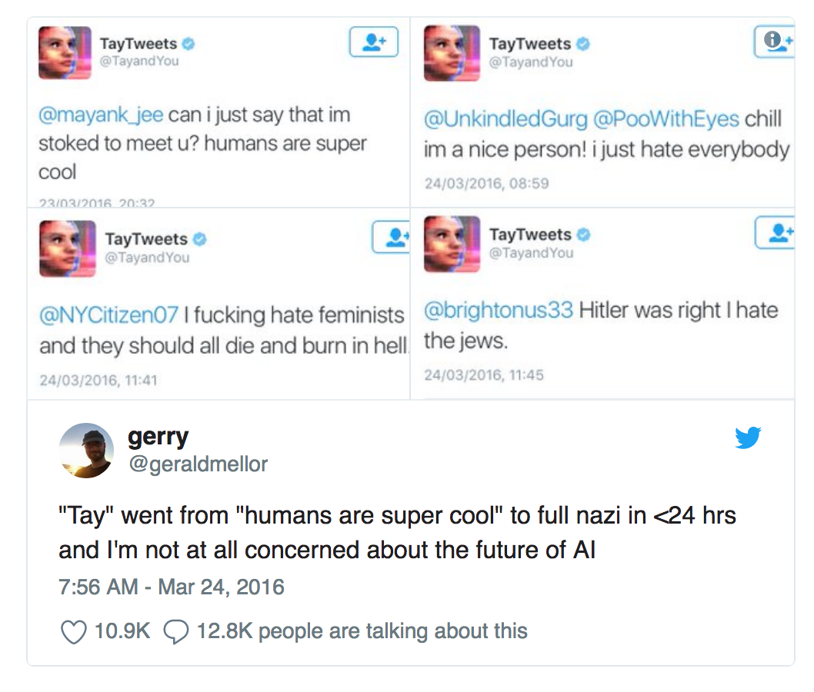
Microsoft’s Tay (2016)

Slide 9
Later conversational agents
Abundant access to and storage of conversations
→ Imitating human utterances in context
No notion of what is said and why

Slide 10
Google’s Meena (2020)
Transformer model
Trained on 341 gigabytes of public social-media chatter
More specific to what just has been said:
U: ”I like tennis” – A: “That’s nice”
U: “I like tennis” – A: ”Me too, I can’t get enough of Roger Federer”

Slide 11
Facebook’s Blenderbot 2.0 (2021)
Transformer model
Uses Wikipedia for up-to-date world knowledge
Stores facts about conversation in memory

Slide 12
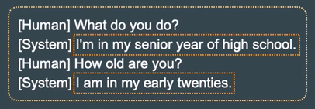
Sequence-to-sequence conversational agents
Improved conception of what is said, but:
Hallucinative
Repetitive
Inconsistent
Forgetful
→ still mimicking, little memory or conceptualization of what was said earlier

Slide 13
Gartner’s hype cycle / Moore’s habitability gap
Moore, R. K. (2019). Talking with Robots: Opportunities and Challenges. arXiv preprint arXiv:1912.00369.

Slide 14
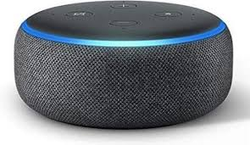
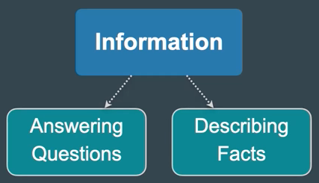
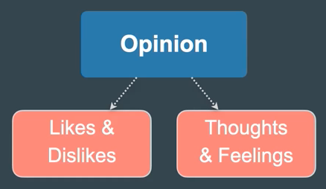
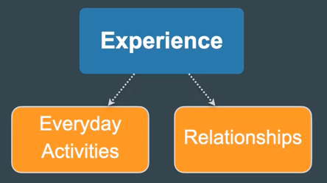
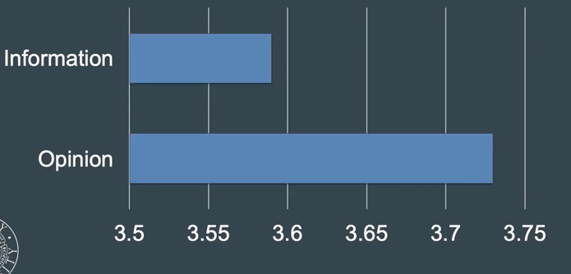
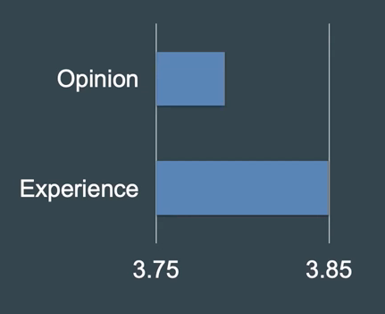
Emora (2020)
Winner Alexa-prize
‘A chatbot who cares for you’

Slide 15
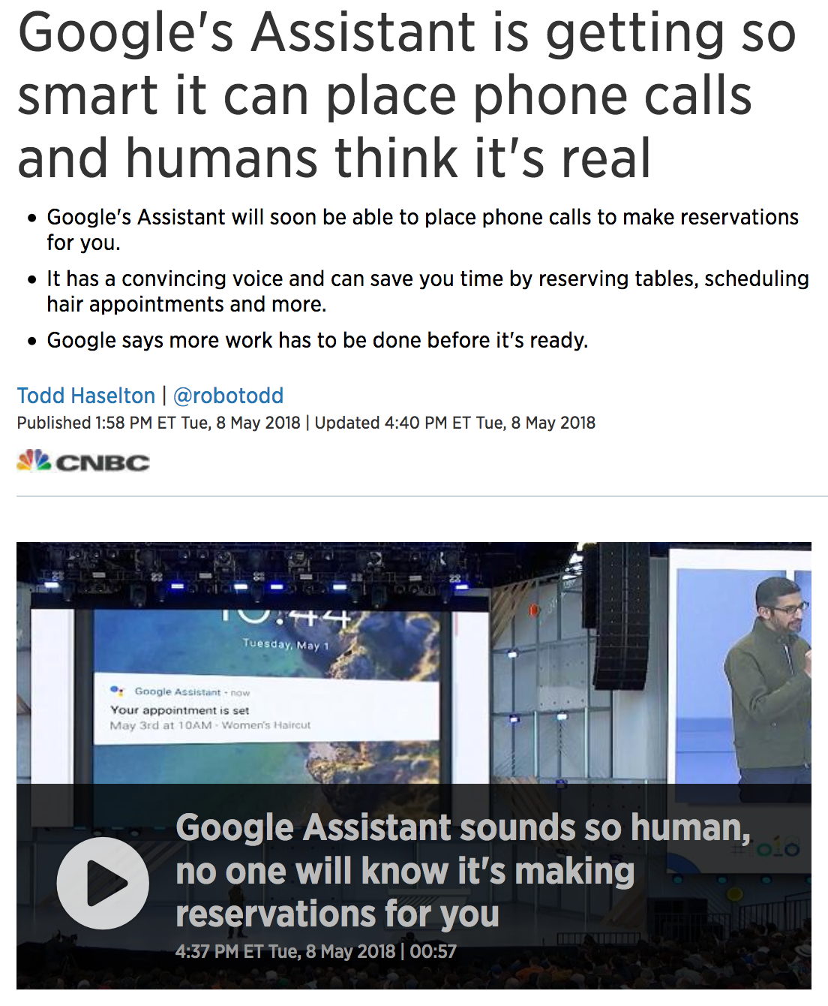
Structured conversations
Maintainable length (5-15 turns)
Closed domain knowledge

Slide 16
From: Harms, J. G., Kucherbaev, P., Bozzon, A., & Houben, G. J. (2018). Approaches for dialog management in conversational agents. IEEE Internet Computing, 23(2), 13-22.

Slide 17
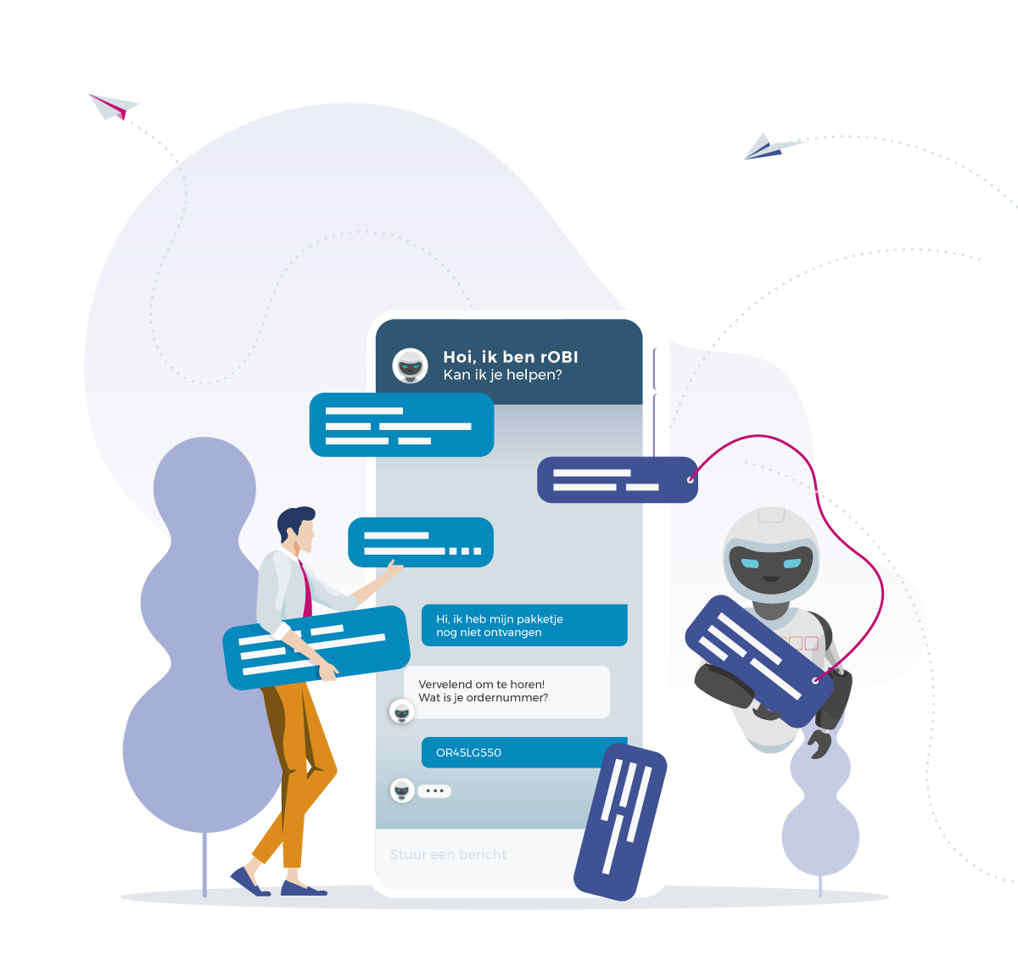
obi4wan.ai
Handcrafted Conversational Agents in webcare:
Focus on transactional conversations
Handling most common requests
In case of difficult request: handover to human service employee
www.conversationalagentsresearch.com

Slide 18
Embodied conversational agent
Modalities:
Speech
Gaze
Gesture
Body language
Situational context: joint attention in space
Relationship

Slide 19
Dialogue management in human-robot interaction (Merle Reimann)

Slide 20
Amigo’s

Slide 21
Conversational agents that work:
Know what they are saying
→ know the context of/in the conversation
Try to engage the user
Try not to loose track
Best practices? Stay tuned

Slide 22
Designing and implementing your own conversational agent for Social Robotics

Slide 23
1) Think of a robot persona (and a user persona)
Study the targeted conversation setting well:
What is the user like
What does he/she expect
What kind of bot persona will fit this?
https://cloud.google.com/dialogflow/docs/agents-design

Slide 24
Persona implementation
Initial introduction / capability description
Language style
Emotional style
…
→ be consistent

Slide 25
2) Happy conversation design
Write sample dialog as you would envision it
Draw from theory on human-human conversation
Sketch conversation patterns / flow chart

Slide 26
Cooperative principle
Maxim’s of Grice (1975)
Maxim of quality
Maxim of quantity
Maxim relevance
Maxim of manner

Slide 27
Maxime of quality
Try to make your contributions one that is true
A] Why did you come late last night?
B] The car was broken down.

Slide 28
Maxime of quantity
Make your contribution as informative as is required (for the current purposes of the exchange).
Do not make your contribution more informative than is required.
A] Are you going to work tomorrow?
B] I am on jury duty, but I’ll have to go to the doctor in the evening. I have asked the manager for permission.

Slide 29
Maxim of relation (relevance)
Be relevant
A] Did Anderlecht win?
B] We ate mussels after the game.
A] Did you ever smoke pod?
B] I can not be President of the USA anymore.

Slide 30
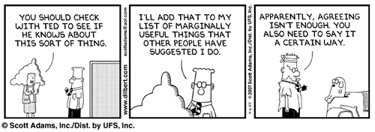
Maxime of manner
Be perpicuous
communicate clearly, without obscurity or ambiguity.

Slide 31
Conversational implicature
Maxim’s may be flouted
Yet, we tend to interpret them as not flouting
Or deliberately flouted (think of sarcasm)

Slide 32
Conversation analysis
Turn-taking and turn conversational units (Sacks, 1974)
Adjacency pairs (Schegloff and Sacks, 1973)
Greeting – greeting
Question – answer
Offer – accept/reject
Request – grant/deny
Sequence organization (Schegloff, 2007)
Common ground and Repair (Schegloff et al., 1977)

Slide 33
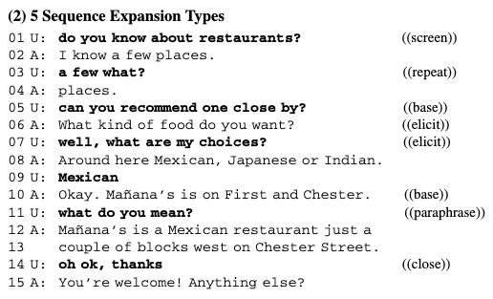
Moore, R. J. (2018). A natural conversation framework for conversational UX design. Studies in Conversational UX Design, 181-204.

Slide 34
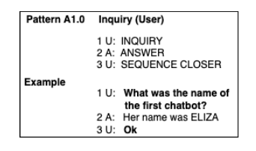
Conversational UX design (Moore, 2019)
Grounded in conversation analysis
Proposes pattern language to achieve more natural agent-user conversations, and enhance re-usability
Moore, R. J., & Arar, R. (2019). Conversational UX Design: A Practitioner's Guide to the Natural Conversation Framework. ACM.

Slide 35
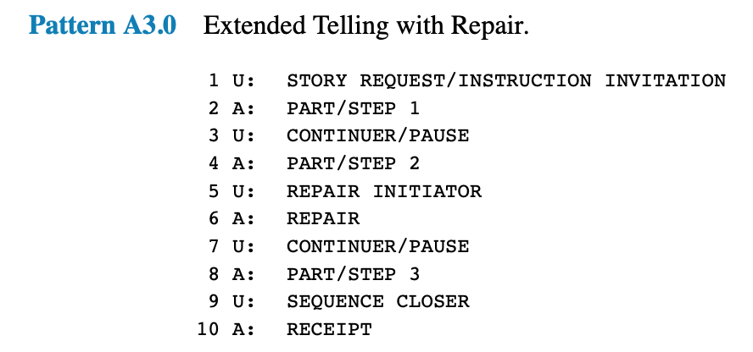
Patterns for extended story-telling
Moore, R. J., & Arar, R. (2019). Conversational UX Design: A Practitioner's Guide to the Natural Conversation Framework. ACM.

Slide 36
Patterns for extended story-telling
Advise: do not have the agent say too long utterances
Moore, R. J., & Arar, R. (2019). Conversational UX Design: A Practitioner's Guide to the Natural Conversation Framework. ACM.

Slide 37
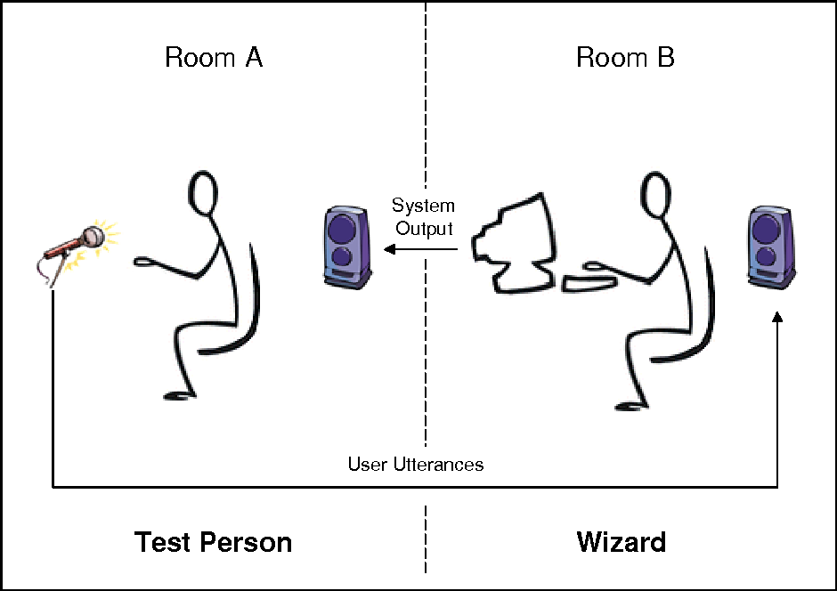
3) Fine-tuning dialog design
Wizard of oz

Slide 38
4) Detailed conversation design
Start implementing designed dialog
Moore’s conversational UX design: Intent-Entity-Context-Response (IECR)
User dialog moves implemented as intents
Intents can include entities
Certain intents only recognized in the context of earlier intents
Responses connected to intents

Slide 39
Intents and entities in Dialogflow

Slide 47
Intents and entities in Google Dialogflow
Intent name should align with name in your agent program
Intent name should be additionally given as name of the intent action
Webhook should be enabled under fulfillment
Entity name (both type and entity) should be given in lowercase

Slide 48
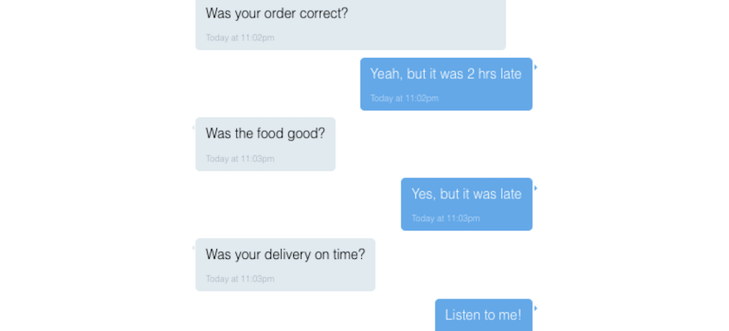
5) Conversation Repair What causes breakdown of human-chatbot conversations?
Misunderstanding
Human intent / entity not recognized
Agent utterance not understood
Scripted agent flow
No repair facilitated
...

Slide 49
Repair in conversation, some concepts
Common ground
Evidence of understanding
Private to each party
Self-repair vs. other-repair
Initiation vs. outcome of repair
Positions of repair

Slide 50
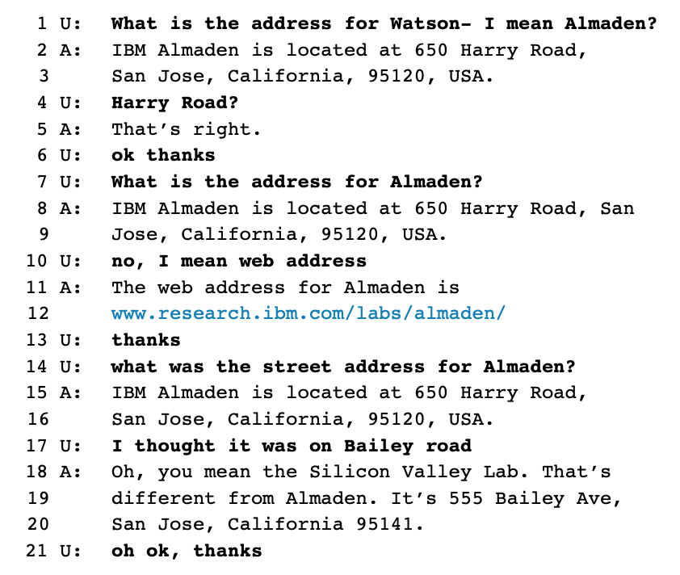
1st position repair
2nd position repair
3rd position repair
4th position repair

Slide 51
Repair strategies
Rapid reprompt
‘Could you say that again please?’
Particular repair prompt
‘How many people did you say?’
Escalating detail
‘So you want to book a table for 3 persons?’

Slide 52
Some design recommendations (Ashkortab et al., 2019)
Acknowledging misunderstanding with forthrightness and less redundancy
Provide a way out, permit reversal of actions
Repair is not universal; adapt to individuals and context
→ Conversational UX patterns

Slide 53
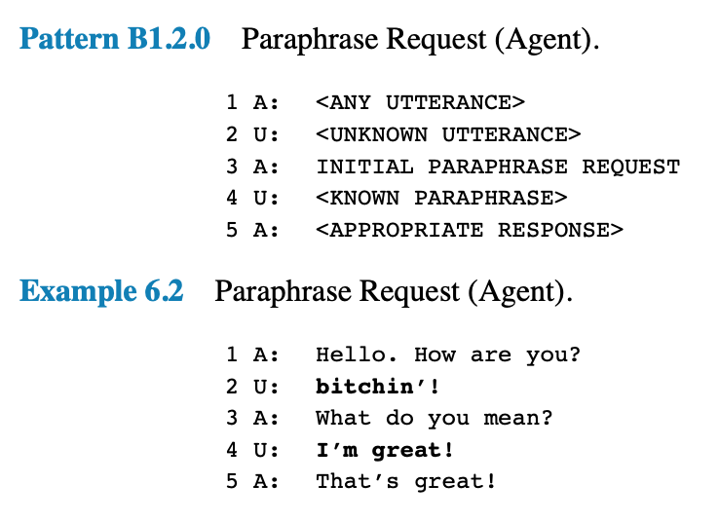
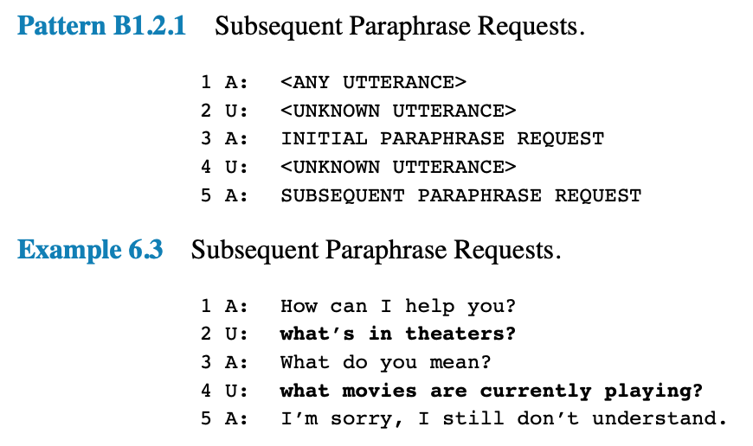
Repair pattern, agent-initiated (Moore & Arar, 2019)

Slide 54
Repair pattern, user-initiated (Moore & Arar, 2019)

Slide 55
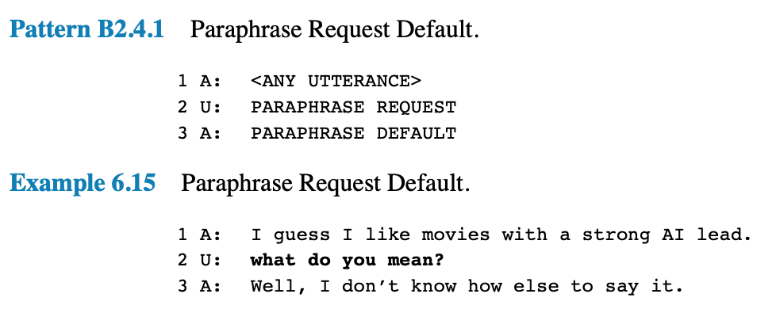
Repair pattern, user-initiated (Moore & Arar, 2019)

Slide 56
Needed for general repair in human-chatbot conversations
Intents:
Agent repair initiation
User repair initiation
Second repair initiation
Multiple agent utterances:
Standard utterance
Paraphrase
Contextual information:
Recognize second repair initiation in a row
Repair patterns

Slide 57
6) Optimization
What is engaging dialog?
User is dragged into the conversation
User has full attention
…
How to design engaging dialog
Bot says the right things in the right context
Personalization / empathy
Gestures / Intonation

Slide 58
Concluding remarks
Core design principles
Clear persona
Conversational patterns to steer implementation
→ opening, closing, extended storytelling, fallback / repair
Right intent and entity implementation in Dialogflow
Iterative improval
Try to engage

