Slide 1
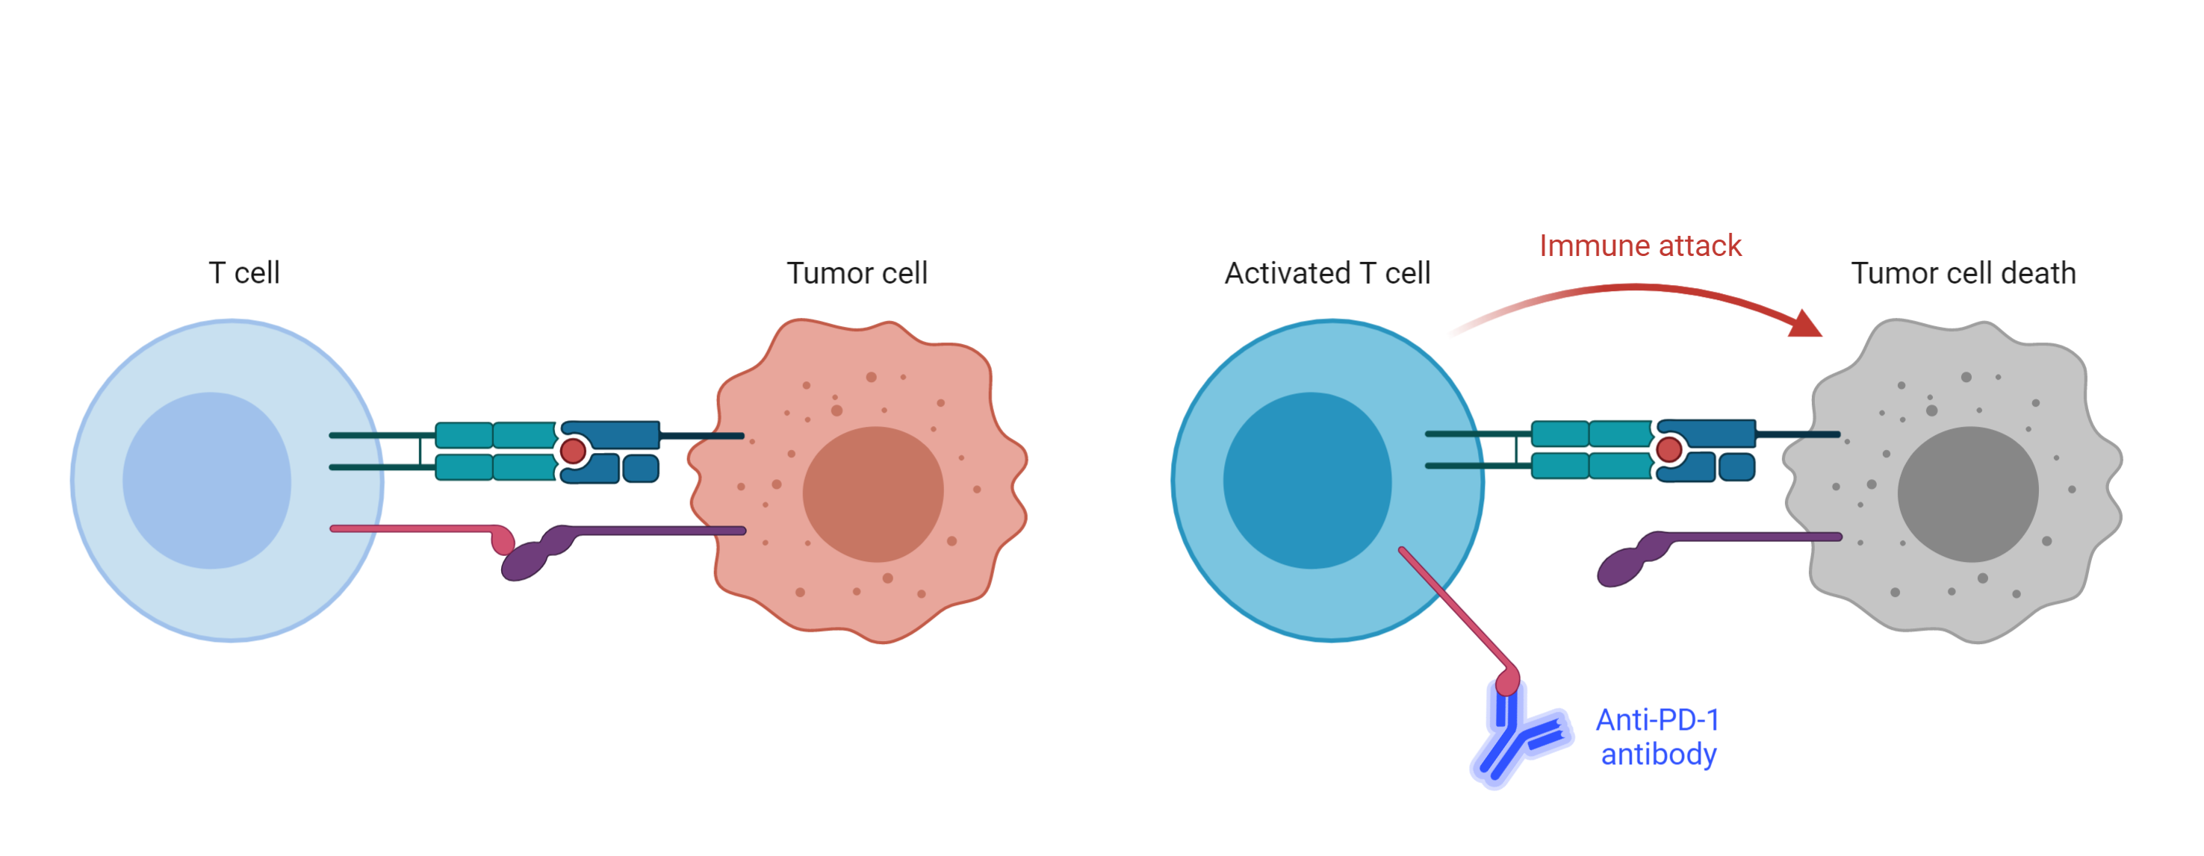
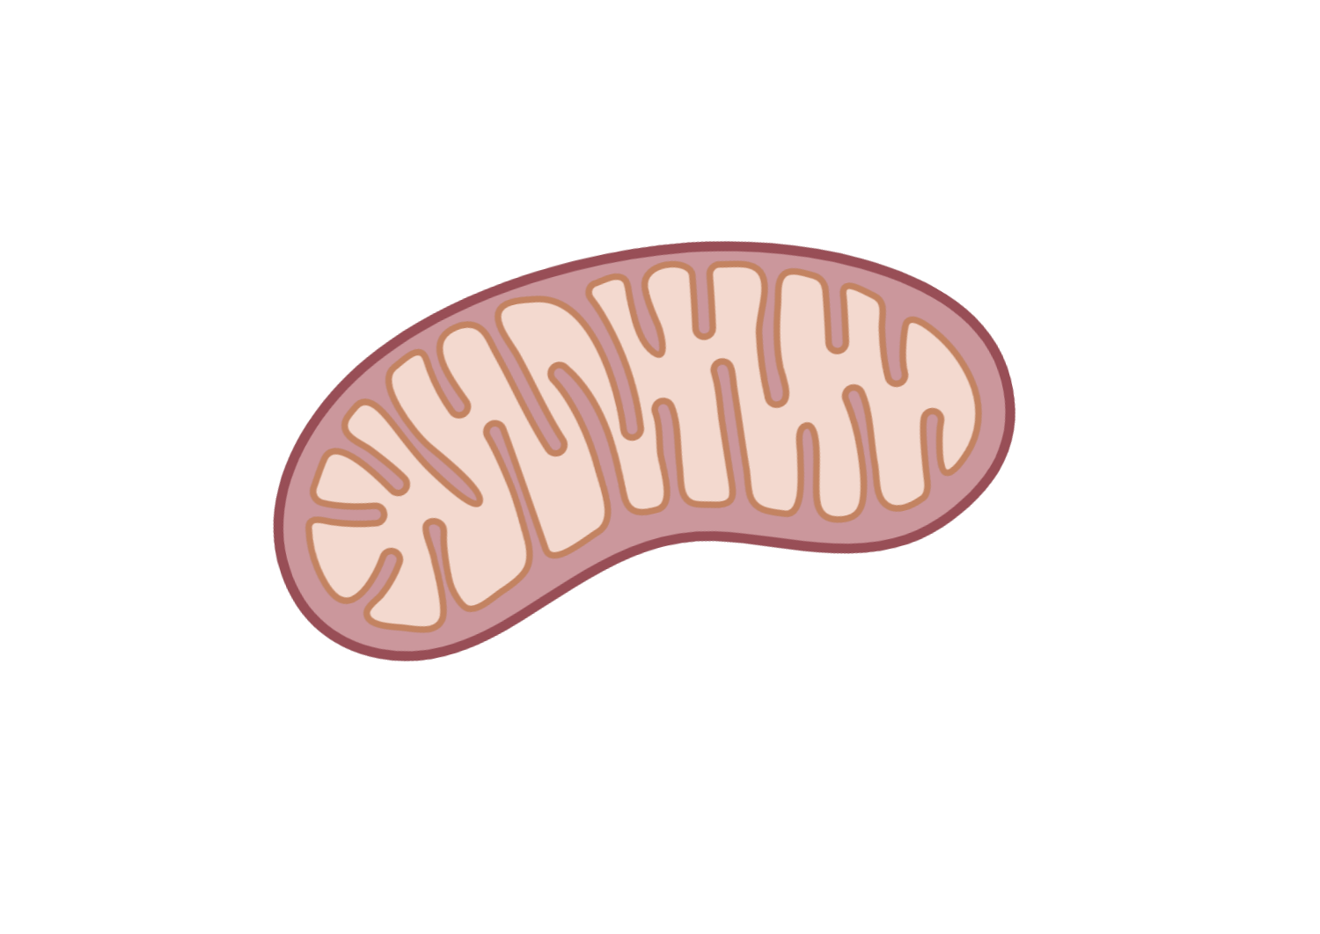
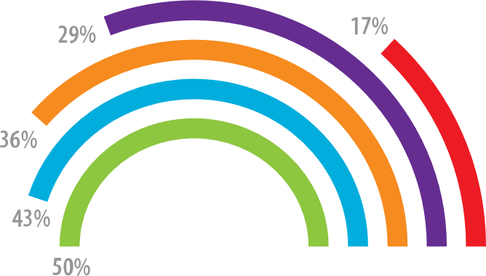
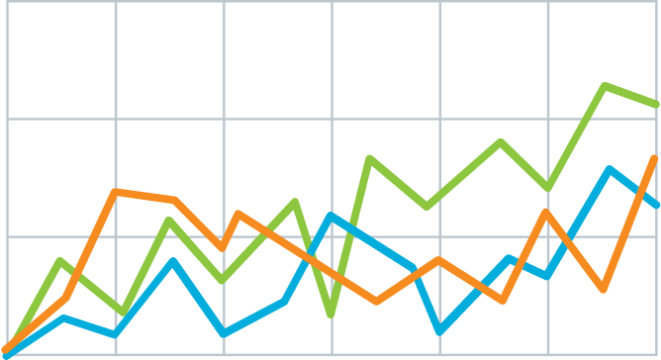
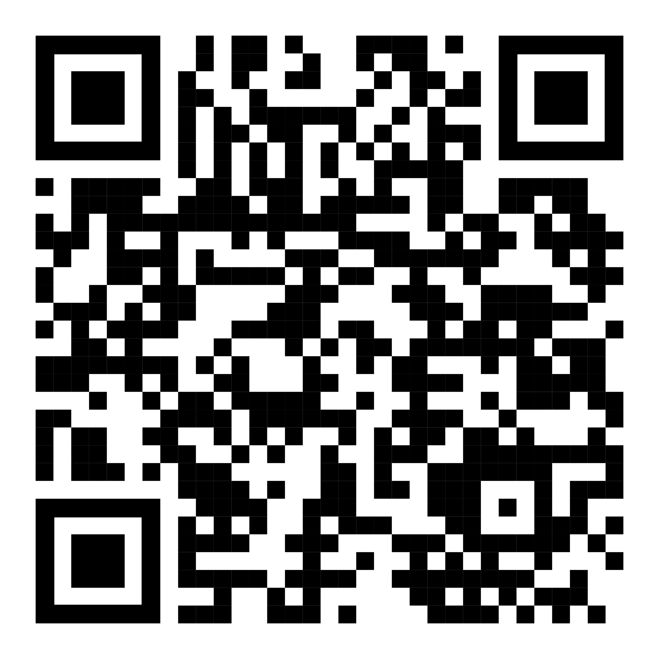
Method
Teach people something cool you learned in 5 seconds as they walk by (or scroll by).
v
Immune checkpoint inhibits T-cell activation.
Anti-PDF-1 antibodies permit T cell activation.
Explain what the graph shows. Like, spoilers are good.
Quickly explain what the graph shows. Help people think.
v
v
(illustrate your takeaway point)
LEM HEWITT, Phillip Merman, Ted crisp EXAMPLE Graphics donated by biorender.com
PrePrint

